Slide 1



AI Hallucination Detector
Jaypee University of Information Technology
Department of Computer Science and Engineering and Information Technology
Major Project - I (18B19CI791) | AY 2025-26
End-Term Evaluation | Dec 12, 2025.
Group No.: 60
Team Member (s)
Arpita Rani (221030055)
Anand Chaudhary (221030123)
Rishal Rana (221030004)
Arnav Sharma (221030059)
Supervisor
Name: Prof. Dr. Vivek Kumar Sehgal
Designation: Professor and Head of Department (CSE & IT)

Slide 2
Outline
Introduction
Problem Statement
Objectives
Literature Review
Work Done (after Mid-Term Evaluation)
Project Design
Tools, Technologies and Languages
Dataset
Implementation
Experimental Results and Evaluation
Key Learnings
Work Contribution and Attendance
Supervisor Interactions
Future Work
Project Plan
References

Slide 3
Introduction
With recent advancements, AI models like GPT, BERT, and LLaMA are being used everywhere from schools and hospitals to banks and customer service. It's impressive how well they can answer questions, but there's a catch: sometimes, they make things up. These “hallucinations” sound convincing, but they’re just not true.
The cause? LLMs don’t “know” facts, they predict what text sounds likely, based on patterns in their training data.
Gaps in data or weird edge cases can make them sound trustworthy when they’re actually fabricating details.
This is a real problem, especially when people are relying on AI for decisions in healthcare, legal stuff, or finance. Nobody wants a chatbot confidently giving out wrong advice!
These errors aren’t rare: research shows hallucination rates can reach up to 80% on some tough queries, like law or science topics.

Slide 4
Problem Statement
Large Language Models (LLMs) generate text by predicting the most likely next word, not by verifying factual accuracy.
This leads to AI hallucinations, confident-sounding but factually incorrect or made-up information.
Hallucinations can include:
  Fake facts or unsupported claims.
  Fabricated citations or references.
  Incorrect or misleading domain-specific advice (e.g., medical, legal, financial).
These errors reduce user trust and pose serious risks in critical areas where accuracy is essential.
Current mitigation techniques (prompt engineering, retrieval-augmented generation, RLHF) only partially reduce hallucinations and lack guaranteed real-time detection.
AI hallucinations remain a challenging and open issue for practical and safe deployment of AI systems.

Slide 5
Objectives
To develop a system that can automatically detect when an AI-generated answer is hallucinated or factually incorrect, ideally as soon as the answer is produced.
To create a high-quality, labeled dataset of AI responses marked as factual or hallucinated for effective model training and benchmarking.
To experiment with state-of-the-art machine learning and NLP techniques (like transformer-based models, semantic similarity checks, and knowledge graph verification) for identifying false information.
To optimize the system so it works reliably in real-world, time-sensitive environments (like web services or APIs).
To make AI-generated content more trustworthy and safe for anyone who uses it whether they're businesses, researchers, or just everyday users.

Slide 6
Literature Review
S. No. | Author & Paper Title [Citation] | Journal/ Conference (Year) | Tools/ Techniques/ Dataset | Key Findings/ Results | Limitations/ Gaps Identified
1. | Brahmaleen Kaur Sidhu, "Hallucinations in Artificial Intelligence: Origins, Detection, and Mitigation" [SR241229170309] | IJSR (2025) | Review; SelfCheckGPT, ChatProtect, GPTScore, RHO, NPH, RAG, MixCL, HERMAN; datasets incl. WikiBio, OpenDialKG | Categorizes AI hallucinations, surveys detection/mitigation models, urges multi-method approaches | Detection tools lack context focus; output quality gaps; factual alignment remains challenging
2. | Zhiyang Chen et al., "Mitigating Hallucination in Visual Language Models with Visual Supervision" [arXiv:2311.16479] | arXiv (2023) | Visual annotation (PSG, SAM), Mask prediction, RAH-Bench | Fine-grained annotation, mask prediction loss, and visual supervision help LVLMs reduce three types of hallucination and outperform baseline models | Data format coupling; limited dataset size; method needs generalization across annotation formats
3. | Dylan Bouchard et al., "UQLM: Uncertainty Quantification for Language Models" [arXiv:2507.06196v1] | arXiv (2025) | Python package 'uqlm', UQ-based scoring methods (Black-Box, White-Box, LLM-as-Judge), multiple existing benchmarks | Provides library for uncertainty-based hallucination detection at generation time; democratizes advanced quantification for LLM outputs | Limited technique scope in prior tools; adoption and ease-of-use for non-experts remains; external fact-checking still a challenge

Slide 7
Literature Review (cont…)
S. No. | Author & Paper Title [Citation] | Journal/ Conference (Year) | Tools/ Techniques/ Dataset | Key Findings/ Results | Limitations/ Gaps Identified
4. | Adam Tauman Kalai et al., "Why Language Models Hallucinate" [OpenAI/Georgia Tech, Sep 2025] | Preprint (2025) | Theoretical analysis, meta-evaluation of LLM benchmarks | Hallucinations arise from statistical pressures in training; binary evaluations reward guessing over uncertainty | Benchmarks penalize uncertainty; socio-technical fixes needed in evaluation/grading; open questions on uncertainty signaling
5. | Zhang et al., “Siren’s Song in the AI Ocean: A Survey on Hallucination in Large Language Models,” 2023 | arXiv preprint (2023). | Literature review across detection & mitigation strategies. | Showed hallucinations are systemic; reviewed detection (fact-checking, NLI, uncertainty) and mitigation (RAG, consistency, instruction tuning). | Conceptual; lacks empirical evaluation; limited to text-based LLMs
6. | Chaoyou Fu et al. MME: A Comprehensive Evaluation Benchmark for Multimodal Large Language Models [Fu et al., arXiv:2306.13394] | arXiv Preprint (2024) | Technique: MME benchmark with manual yes/no instruction-answer pairs. Models: 30 MLLMs (e.g., GPT-4V, LLaVA). Metrics: Accuracy, Accuracy+. | Benchmarked perception (existence, count, color, position, OCR, etc.) and cognition (reasoning, calculation, translation, code) abilities for 30 models. Identified persistent gaps: failure to follow instructions, perception errors, object hallucination, and reasoning limitations. | Models struggle with concise instructions, object perception, and universal robust reasoning. Data leakage risk and challenge of instruction generalization. Not all cognitive tasks achieved high accuracy; further benchmarking needed.

Slide 8
Literature Review (cont…)
S. No. | Author & Paper Title [Citation] | Journal/ Conference (Year) | Tools/ Techniques/ Dataset | Key Findings/ Results | Limitations/ Gaps Identified
7. | Xu et al. Hallucination is Inevitable | ArXiv 2024 | Theoretical proof using learning theory & diagonalization. Defines a formal world with computable LLMs | Proves hallucination is mathematically inevitable for any computable LLM, regardless of architecture or training data. Identifies hallucination-prone problem classes | Analysis is theoretical; doesn't quantify real-world hallucination rates. Assumes deterministic ground truth, limiting probabilistic insights. Focuses on inherent limits,
8. | Maleki et al. AI Hallucinations: A Misnomer Worth Clarifying | Preprint (e.g., ArXiv) 2024 | Systematic review of 14 databases from 2013–2023. Manually extracted and analyzed 333 definitions of "AI hallucination." | Highlights inconsistent and often contradictory definitions across domains. Suggests alternative terms (e.g., fabrication, stochastic parroting). Calls for more precision | Manual review may miss newer definitions. Focuses on terminology, not technical solutions. Limited to English-language papers. Does not propose a unified taxonomy.
9. | Pranab Sahoo et al. A Comprehensive Survey of Hallucination in Large Language, Image, Video and Audio Foundation Models | arXiv Preprint (2024) | Technique: Systematic taxonomy and review of detection/mitigation strategies. | Provides a unified framework and synthesizes detection/mitigation strategies. | Scope is broad, not deep. Cuts off at May 2024, missing recent works.

Slide 9
Literature Review (cont…)
S. No. | Author & Paper Title [Citation] | Journal/ Conference (Year) | Tools/ Techniques/ Dataset | Key Findings/ Results | Limitations/ Gaps Identified
10. | Chuang et al. Lookback Lens | Not Specified (2024) | Technique: Lookback Ratio (attention weight analysis), Linear Classifier, Guided Decoding. Models: LLaMA-2-7B/13B-Chat. Datasets: CNN/DM, XSum, NQ, MT-Bench. | The Lookback Ratio detector matches the performance of complex hidden-state models. It reduces contextual hallucinations by 9.6% in summarization and transfers across tasks and model sizes without retraining. | The method's upper bound is constrained by the LLM's sampling capability. Sampling multiple candidates increases total inference time. The classifier requires 1,000-2,500 annotated examples for training.
11. | Cheng Niu1 et al. RAGTruth: A Hallucination Corpus for Developing Trustworthy Retrieval-Augmented Language Models | arXiv Preprint 2024 | Used GPT-3.5, GPT-4, Llama-2, Mistral-7B to generate responses, Detection methods: Prompt-based (GPT), SelfCheckGPT, LMvLM, Fine-tuned Llama-2-13B, Data set RAGTruth | Data-to-text had the most hallucinations (68%); GPT-4 the least, Mistral-7B the most. Fine-tuned Llama-2-13B reached 78.7% F1 and cut hallucinations by 50–63% | Limitations: Focused only on RAG and three tasks, span-level detection weak, annotations subjective, results may not generalize. Gaps: Need bigger diverse datasets, better subtle hallucination handling, cross-task/multilingual tests
12. | Junyang Wang et al. AMBER: An LLM-free Multi-dimensional Benchmark for MLLMs Hallucination Evaluation | arXiv Preprint 2024 | Proposed AMBER, an LLM-free benchmark for hallucination evaluation in Multi-modal LLMs (MLLMs), Dataset-MS-COCO test set | GPT-4V performed best with the least hallucinations and highest AMBER Score, followed by Qwen-VL and InstructBLIP. However, all models still showed hallucinations, especially in attribute and relation cases | AMBER only evaluates attribute and relation hallucinations in discriminative tasks, not generative ones. Object extraction errors may occur (e.g., “orange” as noun vs color)

Slide 10
Literature Review (cont…)
S. No. | Author & Paper Title [Citation] | Journal/ Conference (Year) | Tools/ Techniques/ Dataset | Key Findings/ Results | Limitations/ Gaps Identified
13. | Balaji Padmanabhan et al. AI Hallucinations: A Misnomer Worth Clarifying | arXiv 2024 | Systematic literature review (14 databases, 333 papers), manual screening, categorization by domain | No consistent definition of “AI hallucination”; term used inconsistently; alternatives like confabulation, fabrication, misinformation; | Focus on definitions not solutions.Need unified taxonomy, standardized non-stigmatizing terms
14. | Varun Magesh et al. Hallucination-Free? Assessing the Reliability of Leading AI Legal Research Tools | Journal of Empirical Legal Studies (2025) | Empirical tests on Lexis+ AI, Westlaw, Practical Law AI, GPT-4 with 200+ legal queries, hand-coded evaluation. | All still hallucinate (Lexis+ ~17%, Westlaw ~33%, Practical Law high incompleteness, GPT-4 worst); RAG helps but not a fix. | Proprietary black boxes, small dataset, US-law only, snapshot in time.Need bigger cross-jurisdiction studies, better benchmarks, lawyer-side mitigation, long-term ethical analysis.
15. | Fan, Aumiller, and Gertz, “Evaluating Factual Consistency of Texts with Semantic Role Labeling,” 2023 | ACL 2023 Proceedings | Semantic Role Labeling (SRL); datasets: QAGS (CNN/XSUM), SummEval. | Proposed SRLScore (reference-free factuality metric); achieved high correlation with human judgment; interpretable | Slower than LM-based methods; only tested in English; occasional mismatch with human evaluations

Slide 11
Literature Review (cont…)
S. No. | Author & Paper Title [Citation] | Journal/ Conference (Year) | Tools/ Techniques/ Dataset | Key Findings/ Results | Limitations/ Gaps Identified
16. | Guliyev and Özer, “On the ‘Hallucinations’ of Artificial Intelligence and Their Terminologies,” 2024. | Cureus (2024). | Conceptual analysis of terminology. | Argues “hallucination” is metaphorical, not literal; proposes using terms like fabrication/confabulation instead. | Theoretical only; no technical solutions
17. | Huang et al., “A Survey on Hallucination in Large Language Models,” 2023. | ACM Computing Surveys (2024). | Literature survey of LLM hallucination studies | Provided taxonomy of hallucinations (factual vs. faithfulness); identified causes (data, model, decoding); reviewed benchmarks like TruthfulQA and HaluEval | Survey only; no new method proposed; limited multimodal/multilingual coverage.
18. | Santosh S. Vempala et al. | arXiv Preprint 2025 | Computational learning theory, binary classification reduction, error analysis, benchmark evaluation review, confidence-targeted evaluation | Hallucinations are statistically inevitable; caused by arbitrary facts, poor models, and evaluation design; benchmarks reward guessing over “I don’t know.” | Mostly theoretical, simplified binary framework, focused on factual QA, little empirical validation.Need fine-grained taxonomy, large-scale empirical tests, domain-specific study, and better evaluation metrics

Slide 12
Literature Review (cont…)
S. No. | Author & Paper Title [Citation] | Journal/ Conference (Year) | Tools/ Techniques/ Dataset | Key Findings/ Results | Limitations/ Gaps Identified
19 | Jeffrey P. Bigham et al. | arXiv preprint / Presented at Human-Centered Machine Learning Workshop (2024); Scheduled at ACL (Vienna, 2025) | MMAU Benchmark PLUM (Pipeline for Learning User Conversations in LLMs) External Validation Tools | MMAU provides more comprehensive and interpretable evaluation compared to older benchmarks. PLUM improves personalization by leveraging conversational history, beyond static user preferences. External validation sometimes improves annotation quality and reduces biases in LLM-as-a-Judge setups. | External validation tools improved results only “often, but not always” Personalization in PLUM still limited to extracted Q–A pairs Apple strong in research output, but practical deployment into consumer-facing AI products lags behind competitors.
20. | Alkaissi and McFarlane, “Artificial Hallucinations in ChatGPT: Implications in Scientific Writing,” 2023. | Cureus Journal of Medical Science (2023) | Tested ChatGPT on medical topics (Homocystinuria, Pompe disease). | Showed ChatGPT fabricates citations and unsupported claims; highlights risks in medical/scientific domains | Case-based only; not systematic; no general detection method proposed .

Slide 13
Work Done (after Mid-Term Evaluation)
Dataset Built:Generated diverse responses per prompt, cleaned & organized into a structured hallucination dataset.
Embeddings & Graph: Converted responses into embeddings and constructed similarity graphs (threshold + k-NN).
Model Development: Implemented GAT model, baseline methods (KNN, classifiers), and contrastive learning for better separation.
Scoring Framework: Integrated semantic similarity, SRL-based fact extraction, and ensemble scoring for reliable detection.
Testing & Results: Performed full evaluation (F1, recall, confusion matrix). GAT outperformed baselines in identifying hallucinations.
Visual Outputs: Created UMAP plots, node distributions, and interpretability reports.

Slide 14
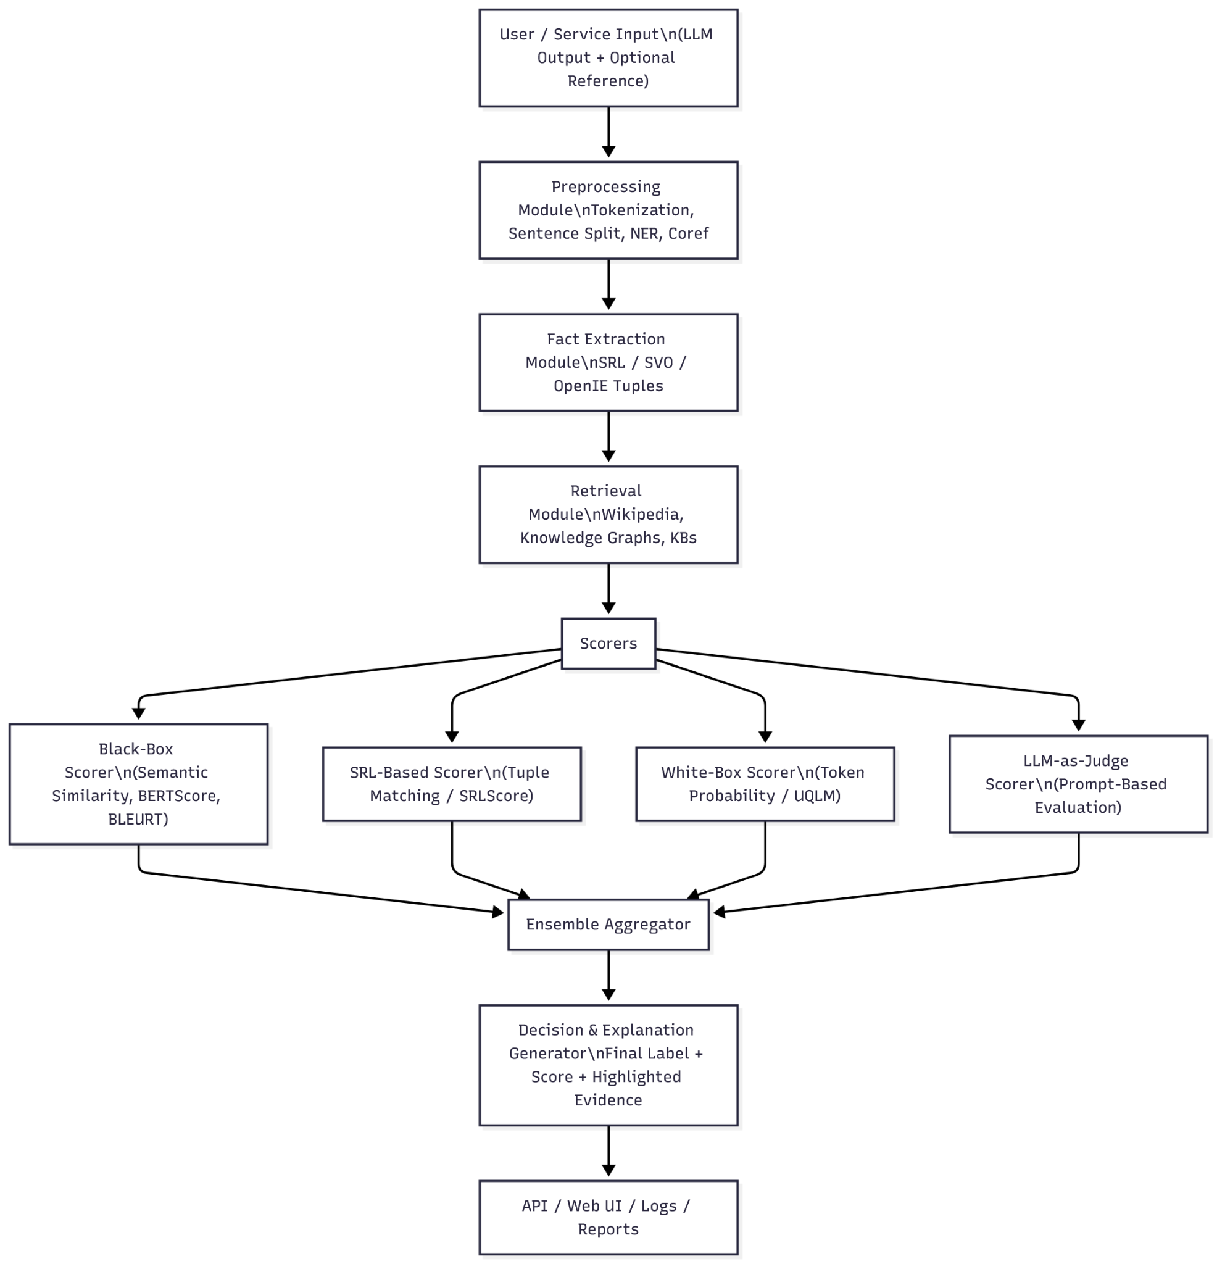
Project Design
Figure 1: Functional Requirements of the AI Hallucination Detector

Slide 15
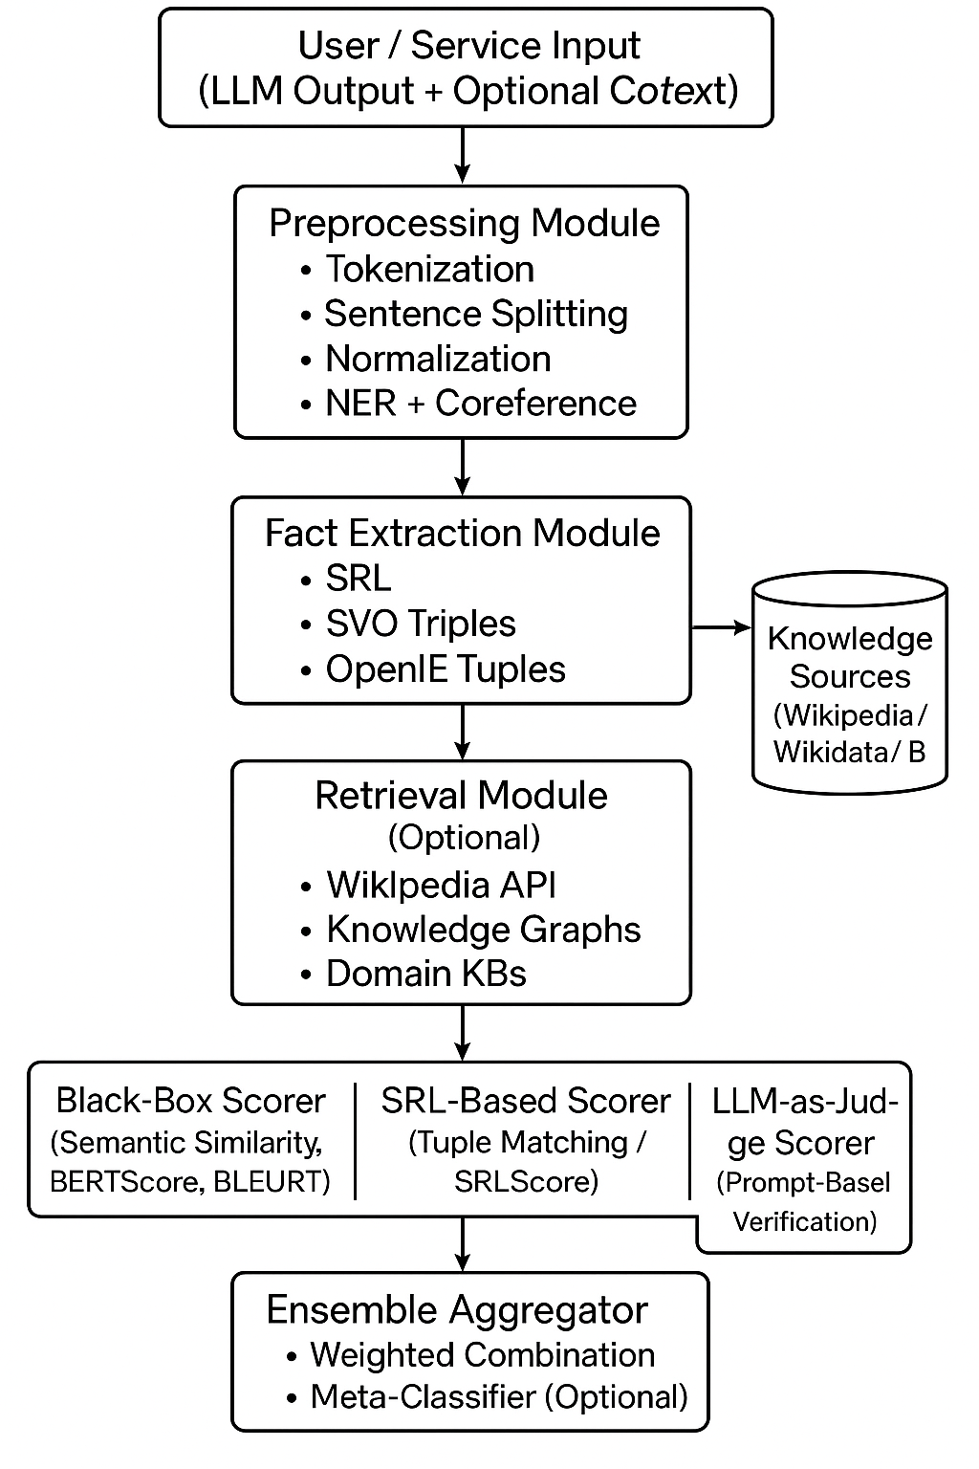
Project Design
.

Slide 16
Project Design
The system follows a multi-stage pipeline architecture to detect hallucinations in Large Language Model (LLM) outputs.
User prompts are processed to generate multiple model responses, which are then transformed into semantic embeddings.
A k-NN based similarity graph is constructed to model relationships between responses.
A Graph Attention Network (GAT) is used to learn contextual reliability patterns and classify responses.
Multiple scoring modules (semantic similarity, SRL-based fact extraction, and black-box scorers) are fused using an ensemble framework.
An explainability layer highlights hallucinated spans and provides interpretable outputs for end users.

Slide 17
Tools, Technologies and Languages
Development Tools
VS Code – Code development and debugging
Jupyter Notebook – Experimentation and analysis
Visualization & Explainability Tools
Matplotlib – Graph plotting and visualization
Seaborn – Statistical and performance visualization
UMAP – Dimensionality reduction and cluster visualization
Deployment & Version Control
Git & GitHub – Version control and collaboration
Streamlit – Interactive web application deployment
Cloud / Compute Environment
Google Colab – GPU-enabled training and testing
CUDA – Hardware acceleration for deep learning workloads

Slide 18
Tools, Technologies and Languages (cont…)
Programming Languages
Python – Core language for model development, data processing, and experimentation
SQL – Dataset handling, querying, and structured data management
Machine Learning & Deep Learning Frameworks
PyTorch – Neural network modeling and training
Hugging Face Transformers – Pre-trained language models and tokenization
PyTorch Geometric (PyG) – Graph-based neural network implementation
Data Science Libraries
NumPy – Numerical computations
Pandas – Data loading, preprocessing, and transformation
Scikit-learn – Baseline models and evaluation metrics

Slide 19
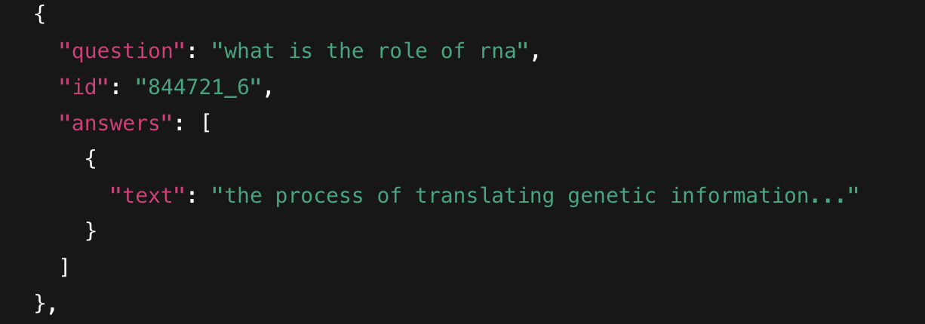
Dataset
The dataset consists of structured JSON entries, each containing:
  question – a query from the user
  id – a unique identifier
  answers – model-generated responses stored under "text" fields
Here is a sample of the Dataset,it includes a question with a unique ‘id’ and a answer text.

Slide 20
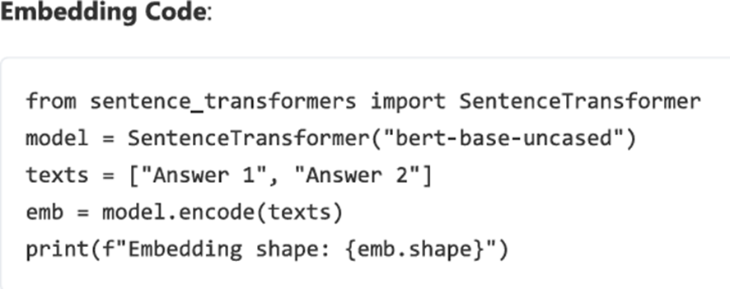
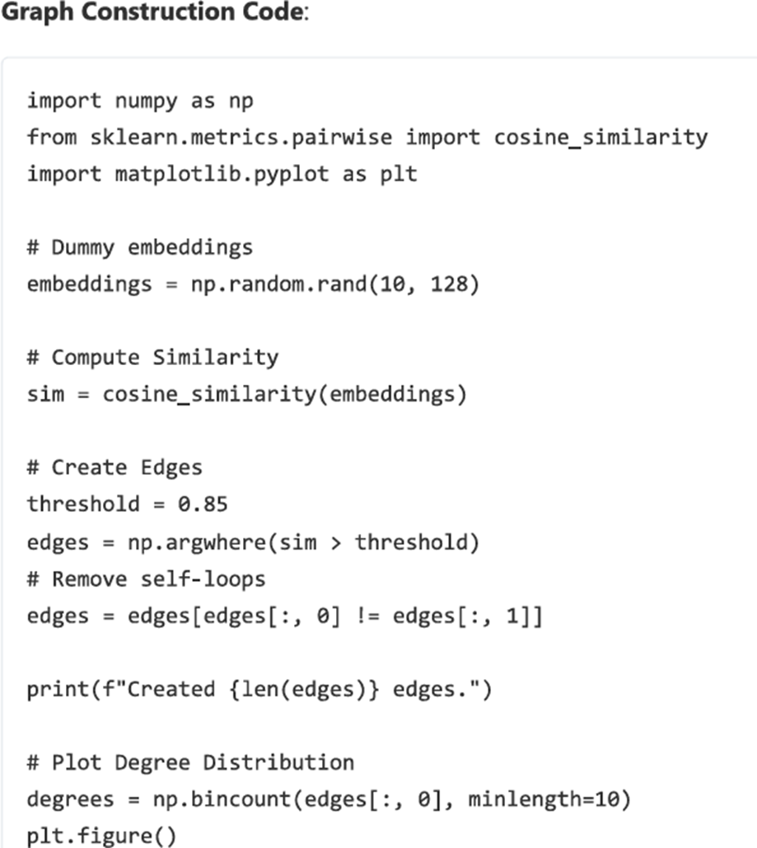
Implementation
Converted text responses into high-dimensional semantic vectors using transformer encoders
Stored embeddings for efficient similarity and graph processing.
Built semantic similarity graphs using k-NN based edge creation.
Nodes represent model responses and edges represent semantic closeness.

Slide 21
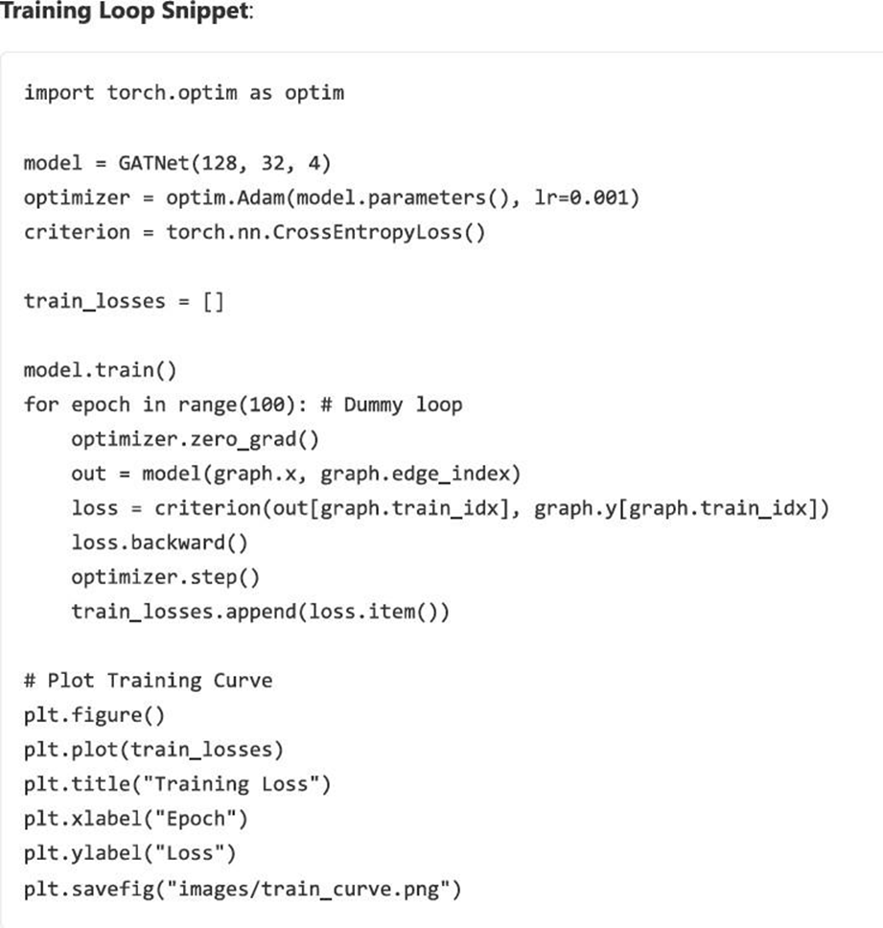
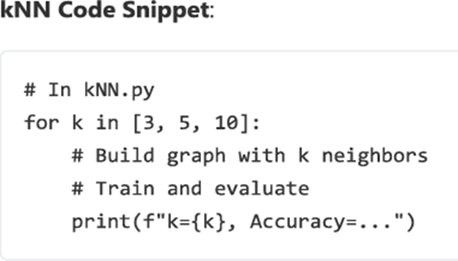
Implementation (cont…)
Constructed a k-Nearest Neighbor (k-NN) graph using cosine similarity between semantic embeddings.
Built node-to-node relationships to model similarity and enable graph-based hallucination detection.
Trained a Graph Attention Network to learn response reliability patterns.
Used attention weights to highlight important semantic relationships.

Slide 22
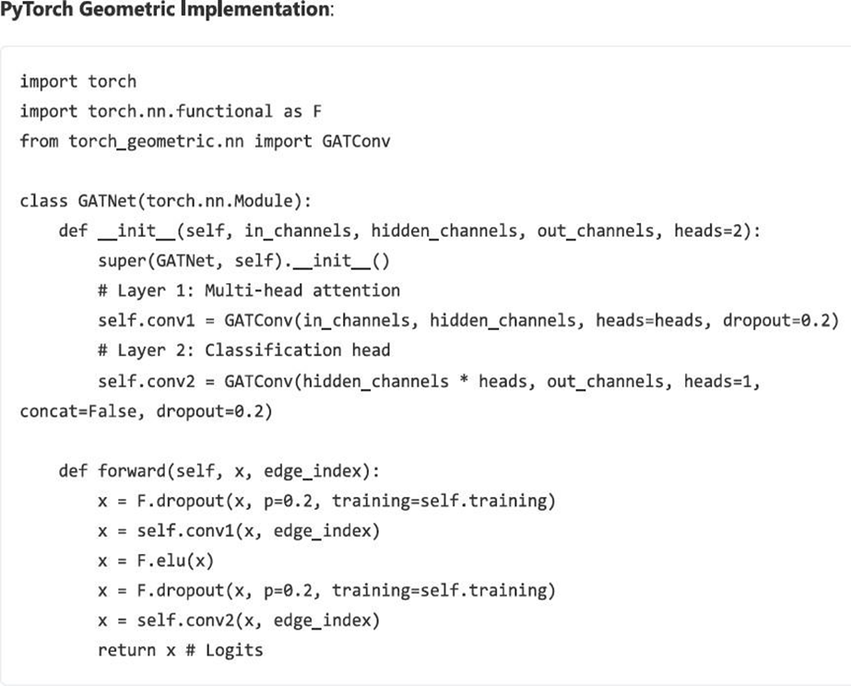
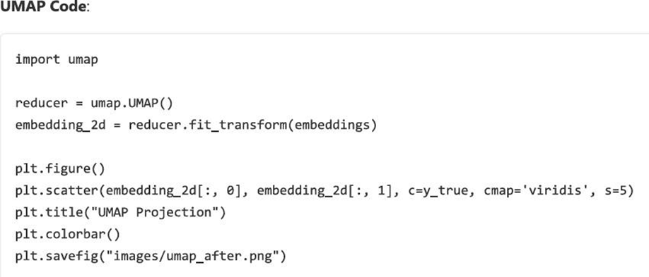
Implementation (cont…)
Used UMAP (Uniform Manifold Approximation and Projection) to reduce high-dimensional embeddings into 2D space.
Visualized cluster separation between hallucinated and factual responses to evaluate embedding quality.
Implemented k-NN graph construction directly in PyTorch using cosine similarity and top-k neighbor selection.

Slide 23
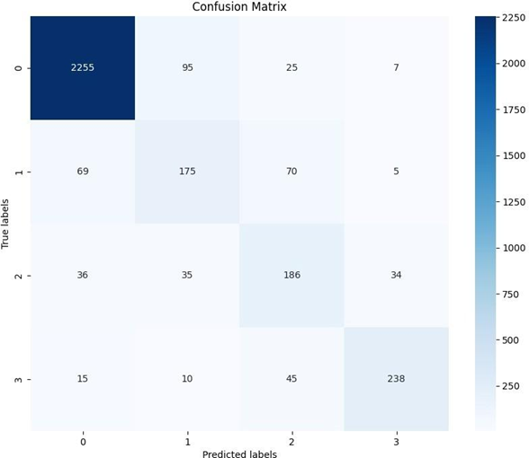
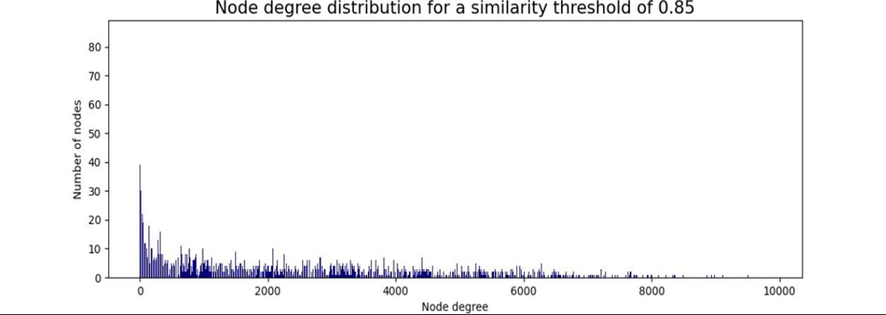
Experimental Results and Evaluation
2. Node Degree Distribution
Graph shows meaningful connectivity between similar responses.
Balanced degree distribution indicates a well-constructed similarity graph.
1. Confusion Matrix
Model correctly separates hallucination,
partial, and correct responses.
Shows strong accuracy for grounded answers
and high recall for hallucinations.

Slide 24
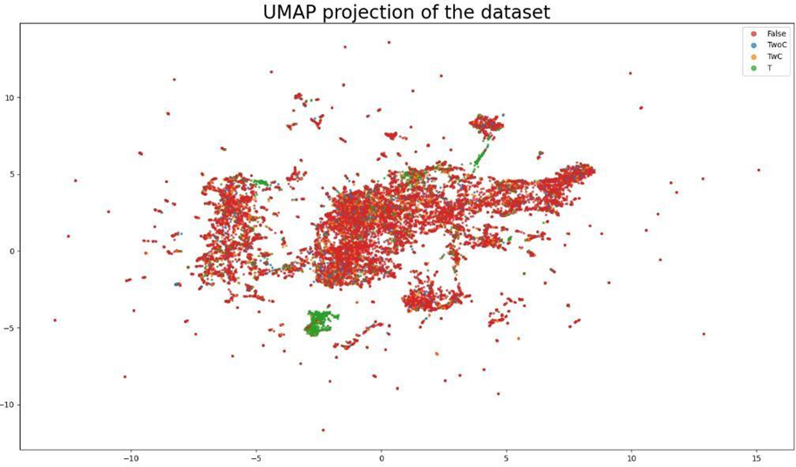
Experimental Results and Evaluation (cont…)
3. UMAP Before Contrastive Learning
Clusters overlap → responses not clearly separated.
Hallucinated and correct answers appear mixed

Slide 25
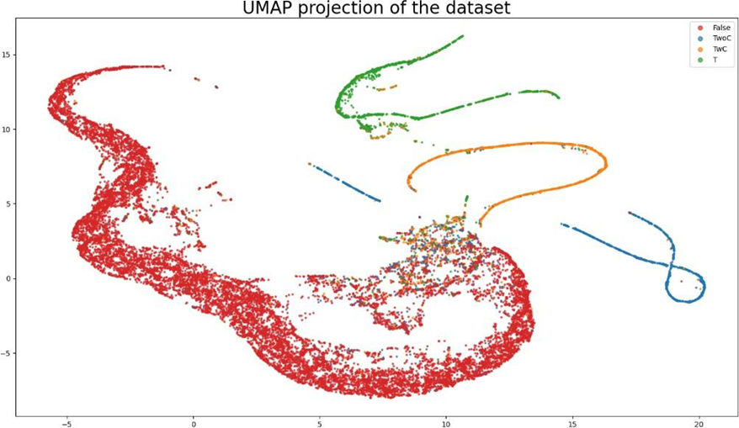
Experimental Results and Evaluation (cont…)
UMAP After Contrastive Learning
Clear separation of clusters → far better distinction between truth vs. hallucination.
Embeddings become more structured and discriminative.

Slide 26
Key Learnings
Developed a strong conceptual understanding of LLM hallucination mechanisms, including error propagation during training, distributional shift, token-level uncertainty, and decoding-induced fabrication.
Learned to build a complete hallucination detection pipeline, integrating data generation, preprocessing, transformer-based embeddings, similarity scoring, and graph-driven analysis.
Gained hands-on expertise in graph machine learning, including k-NN graph construction, semantic similarity networks, node degree analysis, and Graph Attention Networks (GAT) for classification.
Explored contrastive learning to enhance embedding separability, improve latent space structure, and reduce overlap between factual and hallucinated clusters.
Built strong evaluation skills using F1 Score, Recall (Hallucination Class), Confusion Matrix, UMAP dimensionality reduction, and interpretability techniques for model diagnostics.
Strengthened our ability to conduct systematic research, benchmark multiple scorers (black-box, white-box, SRL-based), and perform ensemble-level fusion for robust factuality assessment.

Slide 27
Work Contribution and Attendance
GitHub Repository URL: https://github.com/Anandx3505/AI-Hallucination-Detector/
Team Member | Roll No. | Work Done (provide complete details) | Work Contribution (%) | Lines of Code (if any) | Lab Attendance (%)
1. | 221030055 | Contributed to dataset creation, response generation, and cleaning for building a reliable hallucination dataset. Helped in evaluating the model through confusion matrix, UMAP plots, and interpreting the results. | 25% |  | 100%
2. | 221030123 | Worked on embedding generation and graph construction (threshold + k-NN) along with other team members. Took part in implementing GAT and baseline models and tuning them for better accuracy. | 25% |  | 100%
3. | 221030004 | Collaborated in building the complete pipeline: data → embeddings → graph → model training. Contributed to integrating scorers like semantic similarity and SRL-based fact extraction. | 25% |  | 100%
4. | 221030059 | Participated in designing the system workflow and integrating different modules into one flow. Worked on ensemble scoring and supported in improving interpretability and explanation of hallucinated parts. | 25% |  | 100%

Slide 28
Supervisor Interactions (as mentioned in weekly log)
No. of Meetings with Supervisor:
Week No. | Duration | Remarks (as mentioned in the weekly log) | Incorporated (Yes/No)
1. | 18/08/2025 to 25/08/2025 | Finalized project Read about Illusion of Reasoning | Yes
2. | 26/08/2025 to 29/08/2025 | Instructed the team to research for suitable public datasets Tasked each member to do an in-depth review of one specific paper. | Yes
3. | 30/08/2025 to 03/09/2025 | More research needs to be done. Find out which tech stack you will use. | Yes
4. | 15/09/2025 to 19/09/2025 | Found the expanded list of 20 research papers for the literature survey. Advised on the structure for the Mid-Term presentation | Yes
5. | 20/09/2025 to 27/09/2025 | Finalized the technical design Good work till now | Yes

Slide 29
Supervisor Interactions (cont…)
Supervisor Interactions (as mentioned in weekly log)
No. of Meetings with Supervisor:
Week No. | Duration | Remarks (as mentioned in the weekly log) | Incorporated (Yes/No)
6. | 27/09/2025 to 31/09/2025 | Designed dataset creation strategy for hallucination detection. Implemented data preprocessing and text cleaning pipeline | Yes
7. | 03/11/2025 to 07/11/2025 | Built semantic embeddings and k-NN based similarity graphs. Implemented baseline and GAT-based models.. | Yes
8. | 10/11/2025 to 14/11/2025 | Visualized embeddings using UMAP before and after contrastive learning. Integrated multi-scorer framework (SRL, black-box, white-box) | Yes
9. | 17/11/2025 to 21/11/2025 | Developed explainability module for highlighting hallucinated text. Completed full pipeline from input to output generation. | Yes
10. | 24/11/2025 to 28/11/2025 | Verified robustness of the model using edge-case prompts. Finalized visualization formats for graphs and performance charts. | Yes

Slide 30
Future Work
Integrate real-time fact verification using live knowledge sources and web APIs.
Add white-box uncertainty modeling using token-level entropy and probability-based scoring.
Extend the system to support multilingual hallucination detection across diverse languages.
Expand towards multimodal hallucination detection including text, images, and video content.
Develop a web-based interface or browser extension for real-time hallucination highlighting.
Implement graph-based knowledge integration using external knowledge graphs such as Wikidata and domain-specific ontologies for deeper factual validation.
Optimize the model for real-time and large-scale deployment in critical domains like healthcare, law, and finance.

Slide 31
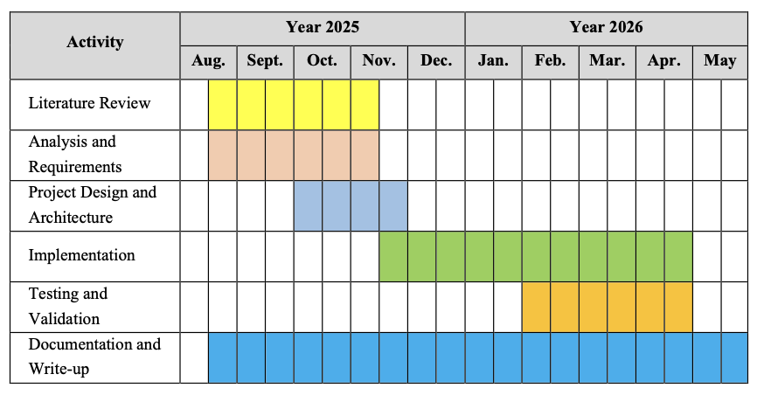
Project Plan

Slide 32
References
[1] Y. LeCun, Y. Bengio, and G. E. Hinton, “Deep learning,” Nature, vol. 521, no. 7553, pp. 436–444, May 2015.
[2] D. Silver, J. Schrittwieser, K. Simonyan, et al., “Mastering the game of Go with deep neural networks and tree search,” Nature, vol. 529, no. 7587, pp. 484–489, Jan. 2016.
[3] A. Vaswani, N. Shazeer, N. Parmar, et al., “Attention is all you need,” in Proc. Advances in Neural Information Processing Systems (NeurIPS), Long Beach, CA, USA, 2017, pp. 5998–6008.
[4] S. J. Russell and P. Norvig, “Search in Complex Environments,” in Artificial Intelligence: A Modern Approach, 4th ed. Upper Saddle River, NJ, USA: Pearson, 2020, ch. 4, pp. 127–180.
[5] C. Fu, Y. Li, S. Yang, et al., “MME: A Comprehensive Evaluation Benchmark for Multimodal Large Language Models,” arXiv preprint, arXiv:2306.13394, 2023.[Online]. Available: https://arxiv.org/abs/2306.13394
[6] Y.-S. Chuang, L. Qiu, C.-Y. Hsieh, R. Krishna, Y. Kim, and J. Glass, “Lookback Lens: Detecting and Mitigating Contextual Hallucinations in Large Language Models Using Only Attention Maps,” arXiv preprint, arXiv:2407.07071, 2024.[Online]. Available:https://arxiv.org/abs/2407.07071
[7] P. Sahoo, P. Meharia, A. Ghosh, S. Saha, V. Jain, and A. Chadha, “A Comprehensive Survey of Hallucination in Large Language, Image, Video and Audio Foundation Models,” arXiv preprint, arXiv:2405.09589, 2024.[Online]. Available:https://arxiv.org/abs/2405.09589
[8] Z. Xu, S. Jain, and M. Kankanhalli, “Hallucination is Inevitable: An Innate Limitation of Large Language Models,” arXiv preprint, arXiv:2401.11817, 2024.[Online]. Available:https://arxiv.org/pdf/2401.11817
‌

Slide 33
References (cont…)
[9] N. Maleki, B. Padmanabhan, and K. Dutta, “AI Hallucinations: A Misnomer Worth Clarifying,” arXiv preprint, arXiv:2401.06796, 2024.Available: https://arxiv.org/pdf/2401.06796
[10] I. Goodfellow, Y. Bengio, and A. Courville, “Optimization for Training Deep Models,” in Deep Learning. Cambridge, MA, USA: MIT Press, 2016, ch. 8, pp. 271–322.
[11] OpenAI, “GPT-4 Technical Report,” arXiv preprint, arXiv:2303.08774, Mar. 2023.[Online]. Available: https://arxiv.org/abs/2303.08774
[12] DeepMind, “AlphaFold: Revolutionizing Biology with AI,” July 2021.[Online]. Available: https://www.deepmind.com/research/highlighted-research/alphafold
[13] A. Karpathy, “The Unreasonable Effectiveness of Recurrent Neural Networks,” Karpathy’s Blog, May 21, 2015.[Online]. Available: http://karpathy.github.io/2015/05/21/rnn-effectiveness/
[14] H. Zhang, Z. Liu, T. He, et al., “Siren’s Song in the AI Ocean: A Survey on Hallucination in Large Language Models,” arXiv preprint, arXiv:2309.01219, 2023.
[15] X. Huang, Y. Xie, S. Zhu, and M. Chen, “A Survey on Hallucination in Large Language Models: Principles, Taxonomy, Challenges, and Open Questions,” ACM Computing Surveys, vol. 56, no. 8, pp. 1–40, 2024.
[16] C. Fan, D. Aumiller, and M. Gertz, “Evaluating Factual Consistency of Texts with Semantic Role Labeling,” in Proc. 61st Annual Meeting of the Association for Computational Linguistics (ACL), Toronto, Canada, Jul. 2023, pp. 1234–1249.
[17] M. Manakul, S. Ladhak, and A. Ghosh, “SelfCheckGPT: Zero-Resource Black-Box Hallucination Detection for Generative Large Language Models,” arXiv preprint, arXiv:2303.08896, 2023.

Slide 34
References (cont…)
[18] A. Lin, J. Hilton, and O. Evans, “TruthfulQA: Measuring How Models Mimic Human Falsehoods,” in Proc. ACL Findings, 2022.
[19] J. Bang, S. Kim, and J. Kang, “Med-HALT: Benchmarking Hallucinations in Large Language Models for Medicine,” arXiv preprint, arXiv:2310.02554, 2023.
[20] Y. Gao, C. Zhou, Z. Liu, et al., “HaluEval 2.0: Dynamic Hallucination Evaluation for Large Language Models,” arXiv preprint, arXiv:2402.06705, 2024.
[21] A. G. Howard, M. Zhu, B. Chen, et al., “MobileNets: Efficient Convolutional Neural Networks for Mobile Vision Applications,” arXiv preprint, arXiv:1704.04861, 2017.
[22] I. Goodfellow, Y. Bengio, and A. Courville, Deep Learning. Cambridge, MA, USA: MIT Press, 2016.
[23] M. Alkaissi and S. I. McFarlane, “Artificial Hallucinations in ChatGPT: Implications in Scientific Writing,” Cureus, vol. 15, no. 2, pp. e35179, Feb. 2023.
[24] R. Guliyev and F. Özer, “On the ‘Hallucinations’ of Artificial Intelligence and Their Terminologies,” Cureus, vol. 16, no. 7, pp. e62731, Jul. 2024.
[25] OpenAI, “Why Language Models Hallucinate,” OpenAI Research, 2025.

Slide 35

Thanks.

